Slide 1

Bank Marketing Campaign
Taimoor Razi
Akshar Chaklashiya
Ogwu Augustine
Date: 15-09-2022
Notes:
Hello and welcome, my name is Taimoor Razi and today me and my team members, Akshar Chaklashiya and Ogwu Augustine will be presenting to you the results of the Data Glacier Team on our clients Bank Marketing Campaign.

Slide 2
Outline
Executive Summary
Problem Statement
Approach
Model Preparation
Model Building
Model Results
Recommendations
Notes:
Today’s outline will be as follows:
1. We will give the executive summary and describe the problem statement of the project to give a high level understanding of the business problem we're tackling and the specific requirements.
2. I will then go over the approach that we followed to complete this task, so that you have complete clarity in how we tackle these kinds of tasks.
3. Then, Akshar will go over the Data Analysis we performed and all important results and he will present them as a series of insights and visualizations from our analysis.
4. To wrap up, August will summarize and give recommendations and proposed the ML models to proceed further in the ML pipeline. Finally, our team will be open for any questions.

Slide 3

ABC Bank wants to sell it's term deposit product to customers and before launching the product they want to develop a model which help them in understanding whether a particular customer will buy their product or not (based on customer's past interaction with bank or other Financial Institution).
Executive Summary
Bank wants to use ML model to shortlist customer whose chances of buying the product is more so that their marketing channel (tele marketing, SMS/email marketing etc) can focus only to those customers whose chances of buying the product is more.
Notes:
To kick things off let me recap this engagement.
ABC Bank wants to sell it's term deposit product to customers and before launching the product they want to develop a model which help them in understanding whether a particular customer will buy their product or not (based on customer's past interaction with bank or other Financial Institution).
We, Data Glacier are here to help you understand the market and guide you in the right direction.

Slide 4
Data Glacier Objective : Provide actionable insights to help XYZ firm in identifying the right customers for targeting the marketing campaign.
This will save resource and their time ( which is directly involved in the cost ( resource billing)).
Data Glacier did a 1 month pilot focusing on these tasks:
Data Intake Report
EDA Notebook
ML Model Proposal
Presentation to ABC’s Executive team (Today)
Problem Statement
Notes:
Our Objective was to provide actionable insights to help ABC Bank in identifying the right customers for targeting the marketing campaign.
So, we embarked on a 1 month pilot with ABC Bank to focus on 3 main tasks.
Data Intake Report
EDA Notebook
ML model Proposal
Presentation to ABC’s Executive team which we are here today to present

Slide 5


1
Data Understanding and Extraction
Approach
2
Data Cleaning/Modelling
3
Model Preparation
4
Model Building
5
Model Results
Notes:
So, how did we tackle this problem?
Well we approached it in 5 steps:
1. Data understanding - the key to success on any data project is to understand the data in detail. So we took the time to understand the data model and domain of the business you are interested in.
2. Data extraction - after understanding your business, we then architected what an ideal dataset should look like for this problem and extracted it from the relevant data sources.
3. After extracting the raw data, we needed to process and model this data into a dataset that can precisely answer the business questions and produce analytics.
4. With our new dataset, we used our analytical expertise to uncover insights from this dataset and to produce visualizations to describe the insights.
5. And finally we used these insights to unlock business decisions and to make recommendations on next steps. We also included ML Model proposal at the end of the presentation to get your reviews/feedback before proceeding further to the next stage of model building and preparation.

Slide 6
Data Overview
UCI ML Repository
bank-additional-full.csv
Notes:
Lets make a quick Data overview. Since today we are here to focus on the analysis and insight, I will quickly go through the Data Overview.
After understanding the data needed for us to make the Analysis we extracted 1 dataset from UCI ML Repository which was used to perform analysis.

Slide 7
Bank Data
21 Features
Data Overview
41188 data points
5834924 bytes
Notes:
The resulted dataset had 21 features i.e., columns and 41188 data points i.e., rows with a total size of 5834924 bytes. Also note that in addition to our original 21 features we created some new features to help with our analysis. One of these features was month-day. Data Cleaning And Transformation was then done which is outside the scope of todays presentation.

Slide 8
Removed Default column
Handle Outliers: box plot to detect outlier.
6 of the categorical variables have an "unknown" value.
Replaced them with the most frequent category for the column
Model Preparation

Slide 9
Logarithmic Transformation is applied to the "age" variable in order to get a more Gaussian-like distribution.
Yeo-Johnson transformation is applied to duration variable to obtain gaussian like distribution.
Binary features, house and loan, values of “yes” and “no” are replaced with “1” and “0”.
Ordinal Encoding is done for education column
Model Preparation

Slide 10
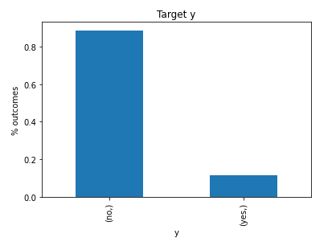
Imbalance Data: Over Sampling
Model Preparation

Slide 11
Random Forest
The process of this method is:
Take a sample of size n from the training dataset;
Randomly choose p variables from all the variables available;
Train a single big tree on the sample dataset and using p variables;
Repeat the step above B times;
Take a majority vote of the results for all of the B trees.
Model Building

Slide 12
Random Forest
RandomForestClassifier class from sklearn is used to create the model.
Hyperparameter tuning is done over n_estimators and max_depth of the ensemble through grid search with five-fold cross-validation.
Model Building

Slide 13
Random Forest
RandomForestClassifier class from sklearn is used to create the model.
Hyperparameter tuning is done over n_estimators and max_depth of the ensemble through grid search with five-fold cross-validation.
Model Building

Slide 14
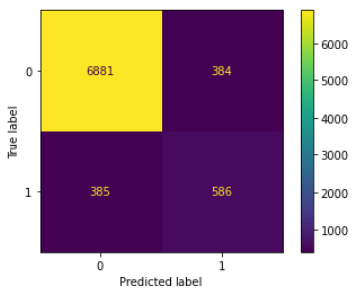
Random Forest
The test accuracy of 90.66% was obtained with a ROC AUC score of 93.8%.
The confusion matrix
Model Results

Slide 15
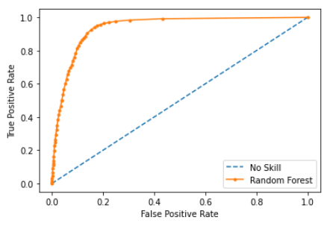
Random Forest
The test accuracy of 90.66% was obtained with a ROC AUC score of 93.8%.
The ROC AUC Curve
Model Results

Slide 16
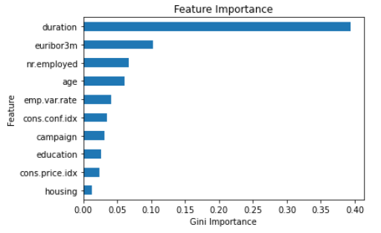
Feature importance for Random Forest

Slide 17
Extreme Gradient Boosting
Popularly called XGBoost;
model works to accurately predict a target variable by combining the estimates of a set of simpler, weaker models;
Tree based ensemble machine learning algorithm- scalable machine learning system for tree boosting;
Hyperparameter tuning - carried out over learning_rate, n_estimators, max_depth, colsample_bytree, and subsample through random search with a 10-fold cross validation;
Model Building

Slide 18
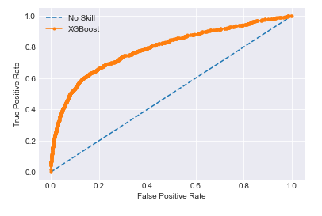
Extreme Gradient Boosting
Test accuracy : 82.4% , Train Accuracy: 78.9%
ROC AUC score: Without hyper-param: 62.9%
ROC AUC score: with hyper-param: 60%
Model Results

Slide 19
Logistic Regression
one of the most popular Machine Learning algorithms;
It is used for predicting the categorical dependent variable using a given set of independent variables
It predicts the output of a categorical dependent variable;
we have set an upper limit to train our model up to 3000 iteration, not to overfit our model;
Then we used the GridSerchLogistic algorithm as our final training algorithm.
Model Building

Slide 20
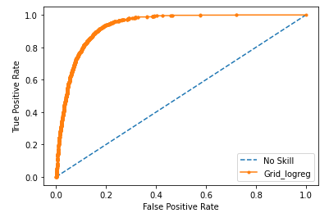
Logistic Regression
Test accuracy : 85.4%, Train Accuracy: 87.9%
ROC AUC score: 86.4%
Model Results

Slide 21

Model Summary - Insights
Random Forest
Random Forest
euribor3m
Best Test Accuracy
Best ROC AUC Score
Most influential variable after duration

Slide 22
ABC bank should:
Hire more people to work for them
Improve the quality of conversation on the phone
Run their campaigns when interest rates are high and macroeconomic environment is stable.
Target old age groups
Recommendations

Slide 23
Reference
1. How to deal with outliers in python -. ProjectPro. (n.d.). Retrieved September 30, 2022, from https://www.projectpro.io/recipes/deal-with-outliers-in-python
2. Detecting and treating outliers: How to handle outliers. Analytics Vidhya. (2022, July 21). Retrieved September 30, 2022, from https://www.analyticsvidhya.com/blog/2021/05/detecting-and-treating-outliers-treating-the-odd-one-out/%20
3. Handling outliers in python. Handling Outliers in Python. (n.d.). Retrieved September 30, 2022, from https://www.datasciencesmachinelearning.com/2018/11/handling-outliers-in-python.html
4. Aleksandradeis. (2019, February 8). Bank marketing analysis. Kaggle. Retrieved September 30, 2022, from https://www.kaggle.com/code/aleksandradeis/bank-marketing-analysis
5. Sklearn.linear_model.logisticregression. scikit. (n.d.). Retrieved September 30, 2022, from https://scikit-learn.org/stable/modules/generated/sklearn.linear_model.LogisticRegression.html

Slide 24
Thank You!
Notes:
Thank you for your time. If you have any questions, please feel free to ask.

